Slide 2
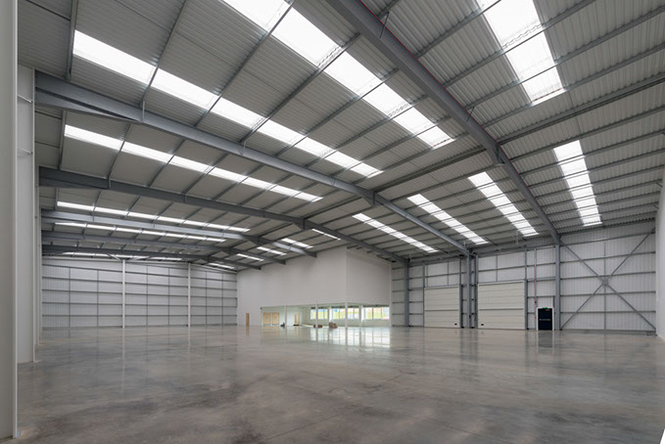
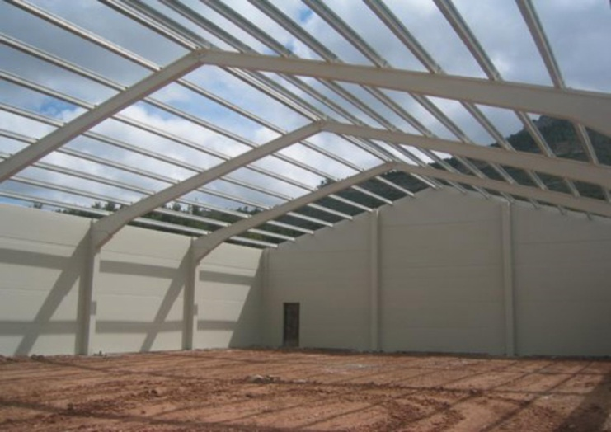
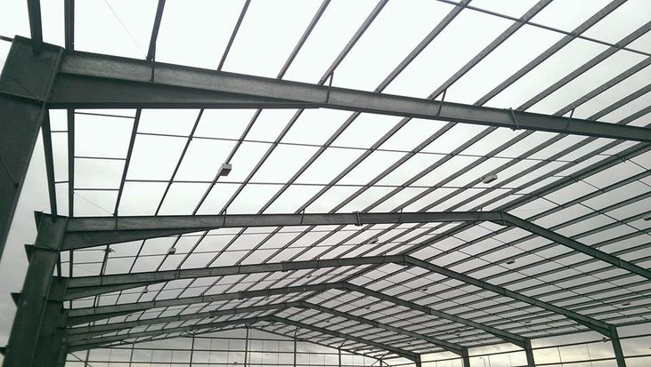
Himalaya College of Engineering
Department of Architecture
AR 604 Building Construction IV
Lectures & Practical - Wednesday & Thursday
Lecturer- Ar. Yam Rai

Slide 3
Examination Scheme
Theory |  |  | Practical |  |  | Total
Assessment Marks | Final |  | Assessment Marks | Final
 | Duration hours | Marks |  | Duration hours | Marks
10 | 1.5 | 40 | 50 |  |  | 100

Slide 4
Course Objective
To provide knowledge to the students about portal frames, shell roofs and dome; fireplaces and chimneys; traditional timber construction; sound and thermal insulation; prevention of fire effects in buildings; measures to protect building components and finishes; various building service elements and about techniques for sustainable construction in buildings.

Slide 5
PORTAL FRAMES

Slide 6
Introduction to Portal frames

Slide 7
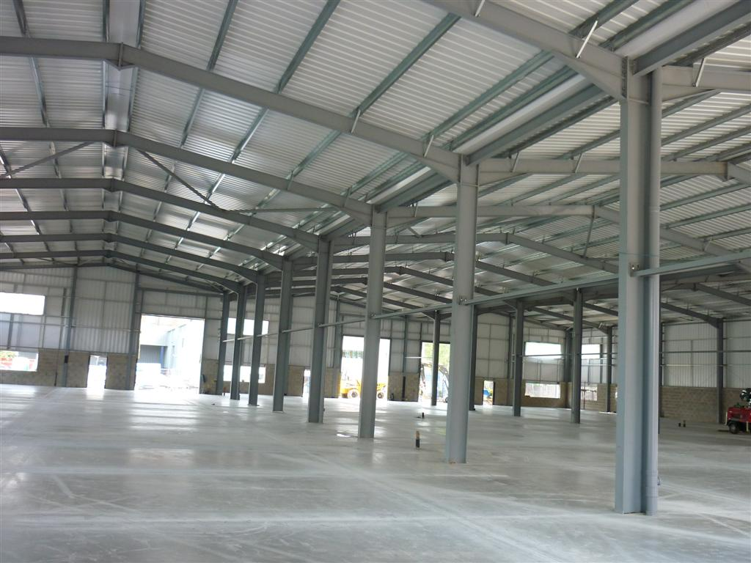
Introduction to Portal frames

Slide 8
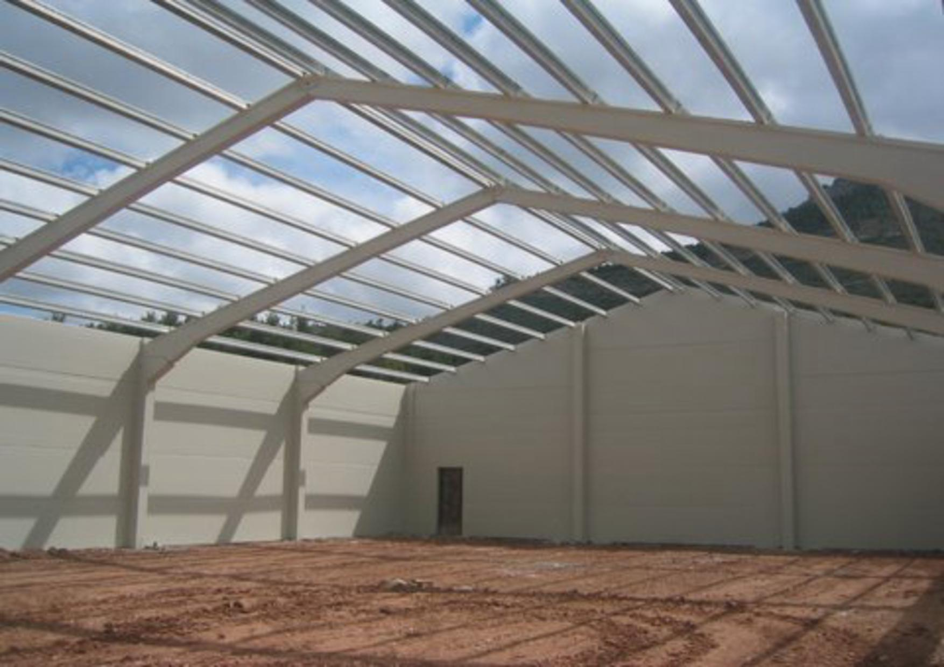
Introduction to Portal frames

Slide 9
Introduction to Portal frames

Slide 10
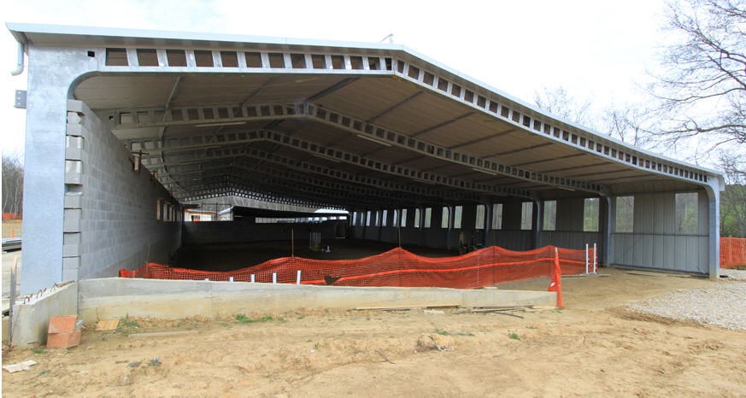
Introduction to Portal frames

Slide 11
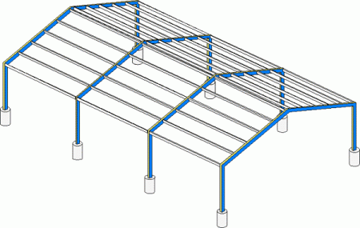
Introduction to Portal frames
Portal Frames
A continuous or rigid frame which has the basic characteristic of a rigid or restrained joints between the supporting members (columns) and the spanning members (beams)

Slide 12
Introduction to Portal frames
Portal Frames
Designed in such a way that it has no intermediate columns, as a result large open areas can easily be created within the structure.
Portal frames are made in a variety of shapes and sizes.
They are usually made from steel but can also be made from concrete or timber.

Slide 13
Introduction to Portal frames
Joints
Joints in portal frame need special consideration especially in transfer of stress from beam to column.
Horizontal thrust/rotational movement at foundation connection needs consideration as well

Slide 14
Introduction to Portal frames
Uses
Generally used for single storey construction which require a large unobstructed floor space
Factories
Shopping centres
Warehouse

Slide 15
Typical Single Storey Portal Frame Formats
Fixed or Rigid Portal Frame
All joints or connections are rigid giving lower bending moments than other formats
Used for small to medium span frames where moments at foundations are not excessive.

Slide 16
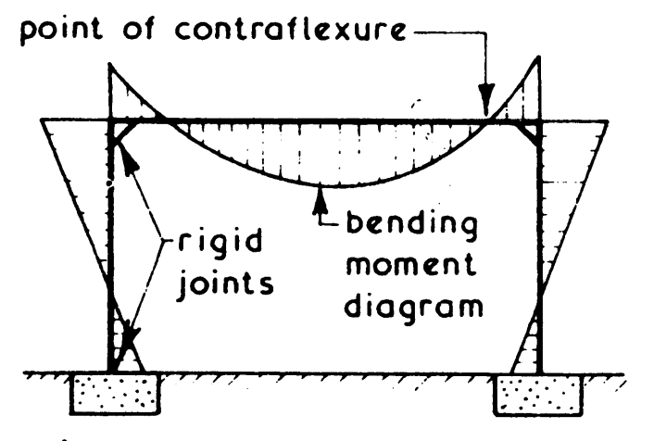
Typical Single Storey Portal Frame Formats
Fixed or Rigid Portal Frame

Slide 17
Typical Single Storey Portal Frame Formats
Two Pin Portal Frame
Pin joints or hinges used at foundation connections to eliminate tendency of base to rotate
Used where high base moments and weak ground are encountered

Slide 18
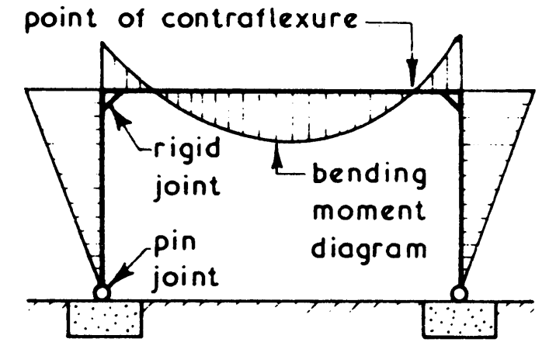
Typical Single Storey Portal Frame Formats
Two Pin Portal Frame

Slide 19
Typical Single Storey Portal Frame Formats
Three Pin Portal Frame
Pin joints or hinges used at foundation connections and at centre of beam which reduces bending moment in beam but increases deflection
Used as an alternative to a 2 pin frame

Slide 20
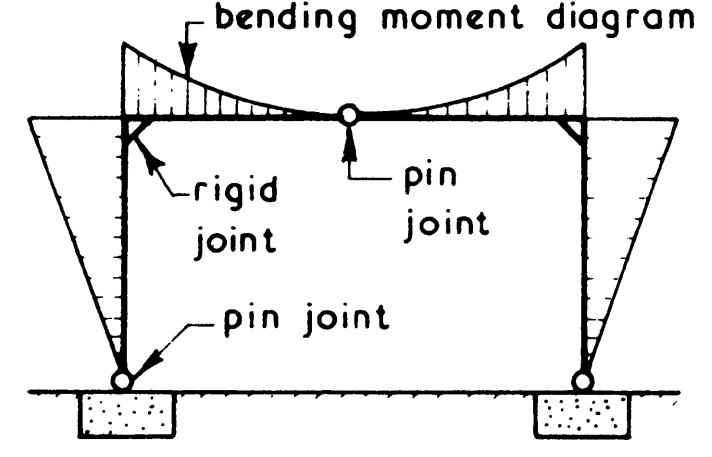
Typical Single Storey Portal Frame Formats
Three Pin Portal Frame

Slide 21
CONCRETE PORTAL FRAME

Slide 22
Concrete Portal Frame
Are manufactured from high quality pre-cast concrete which are suitably reinforced
Two storey and multi-span frames are available
Single span frames are slightly pitched (4° to 22.5 °)
Are designed to carry light weight roofing.
Walls are non-load bearing but have certain degree of fire resistivity, thermal and sound insulation and also withstand wind pressure.
Sheet wall claddings are fixed using hook bolts and purlins.
Foundations are isolated base or pad of RCC.

Slide 23
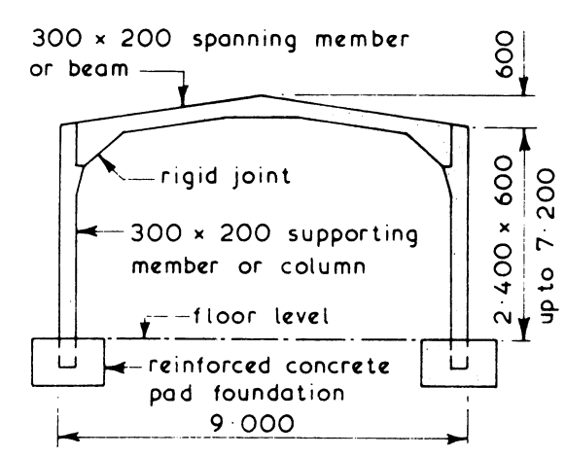
Typical Precast Concrete Portal Frame Details
Typical Single Span Portal Frame

Slide 24
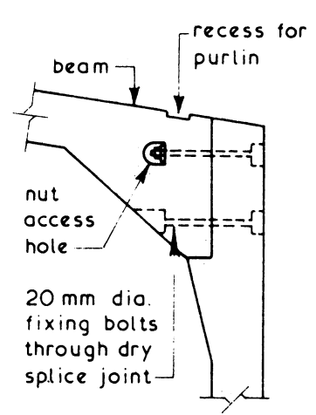
Typical Precast Concrete Portal Frame Details
Typical Beam to Column Joint

Slide 25
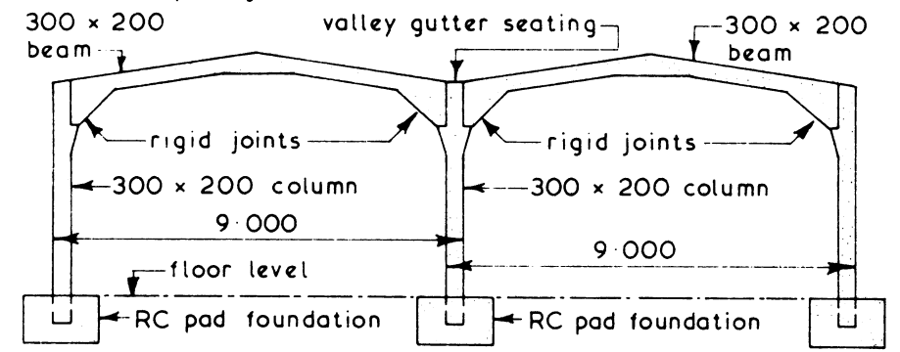
Typical Precast Concrete Portal Frame Details
Typical Multi-Span Portal Frame

Slide 26
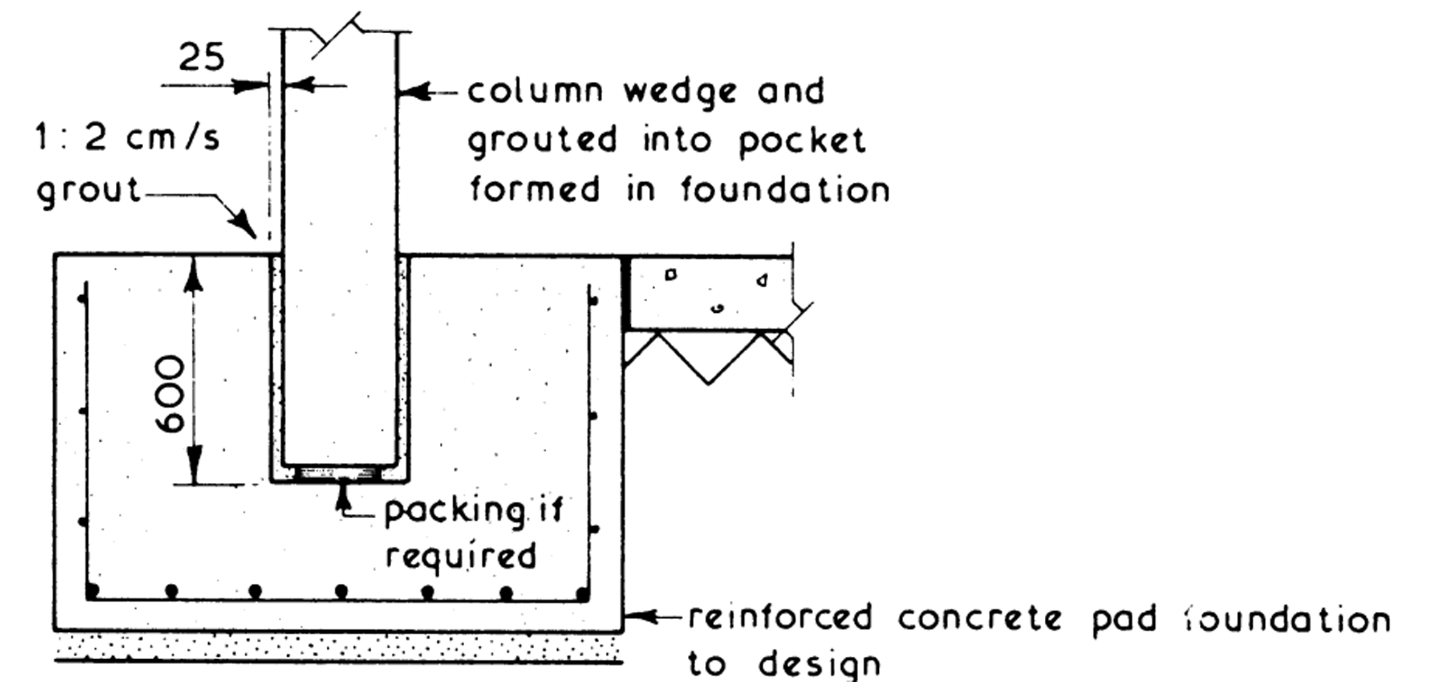
Typical Precast Concrete Portal Frame Details
Typical Foundation Details

Slide 27
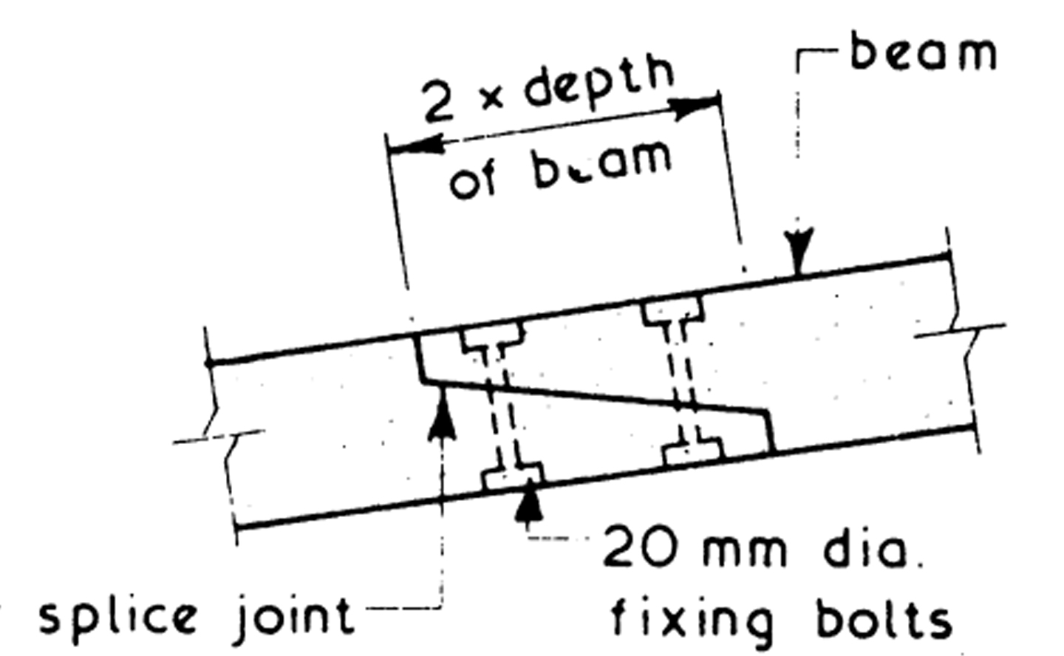
Typical Precast Concrete Portal Frame Details
Typical Splice Joint
(Joint made at point of contraflexure)

Slide 28
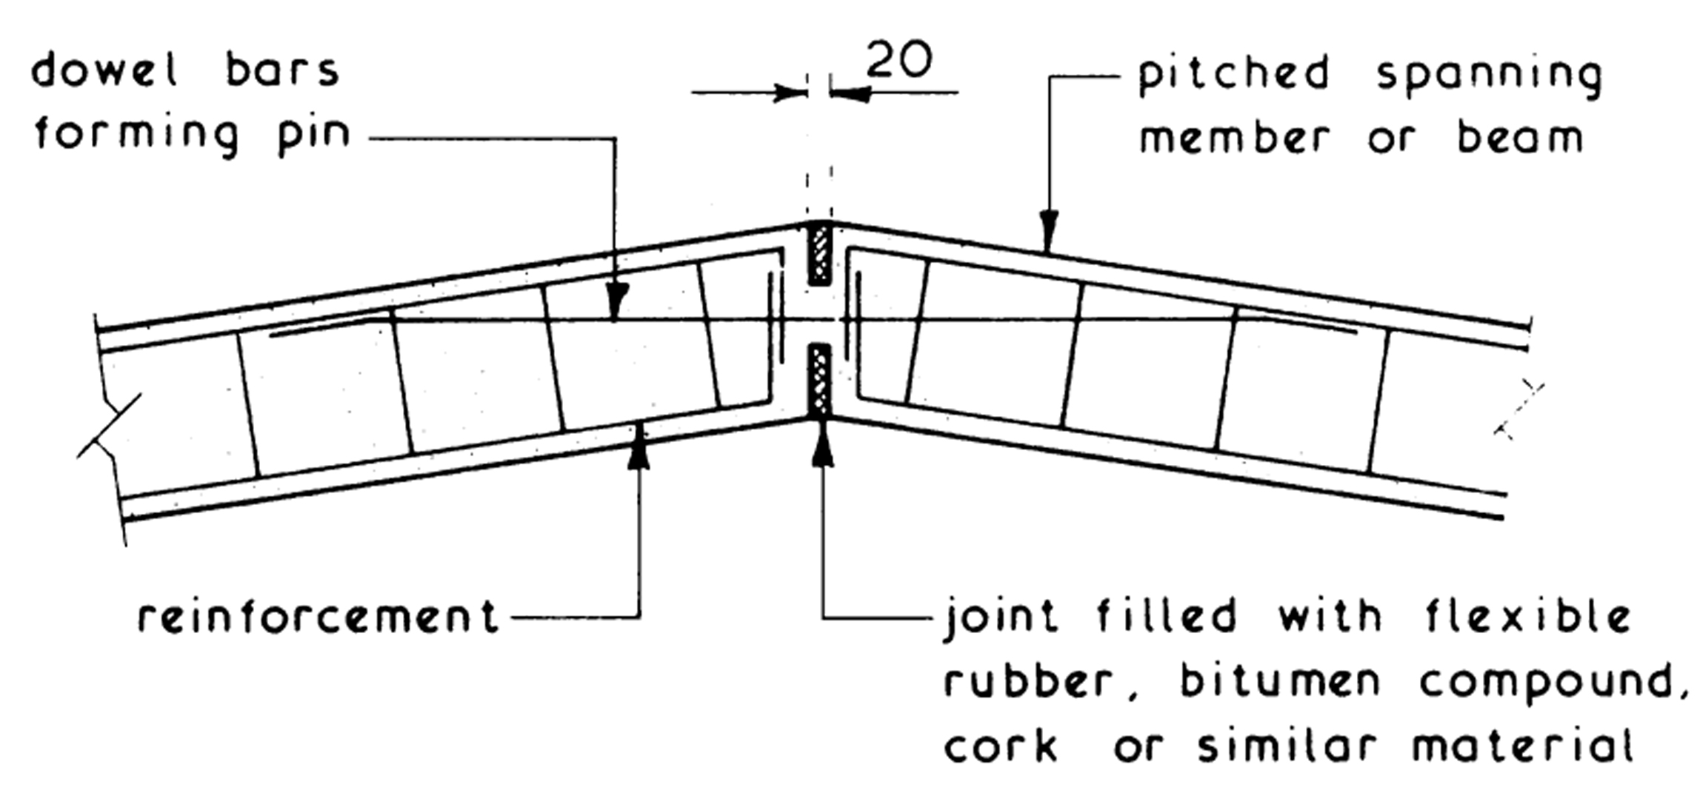
Typical Precast Concrete Portal Frame Hinge Details
Typical Apex or Crown Hinge Details

Slide 29
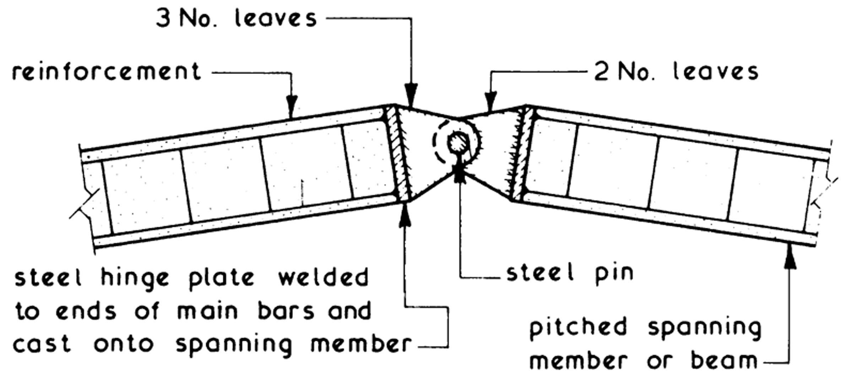
Typical Precast Concrete Portal Frame Hinge Details
Typical Apex or Crown Hinge Details

Slide 30
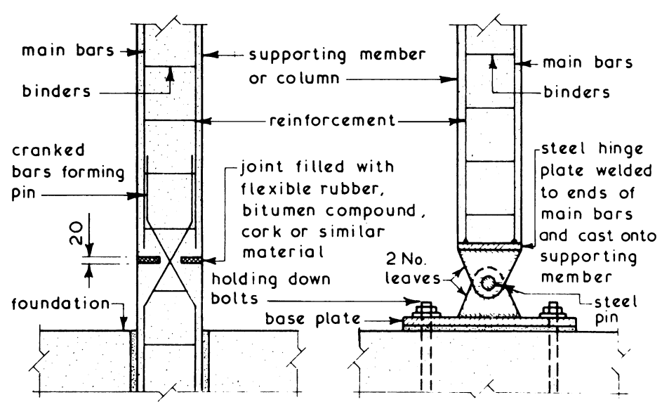
Typical Precast Concrete Portal Frame Hinge Details
Typical Foundation Connection Hinge Details

Slide 31
Concrete Portal Frame
Advantages
Produced in a factory so as to ensure accurate and predictable components
Standard range of components are used
Provide well balanced and flexible design range of roof profiles – single span, multi span
Maintenance is low
Built to resist fire and wind
Erection is of nut-bolt type and is quicker
Clean line of RCC portal are aesthetically pleasing

Slide 32
STEEL PORTAL FRAME

Slide 33
Steel Portal Frame
Standard I-section of beams, columns and box sections are used.
Lattice construction of flats, angles or tubular can also be used.
Welding or bolting is done for fabrication.
Designed to carry light-weight roof covering

Slide 34
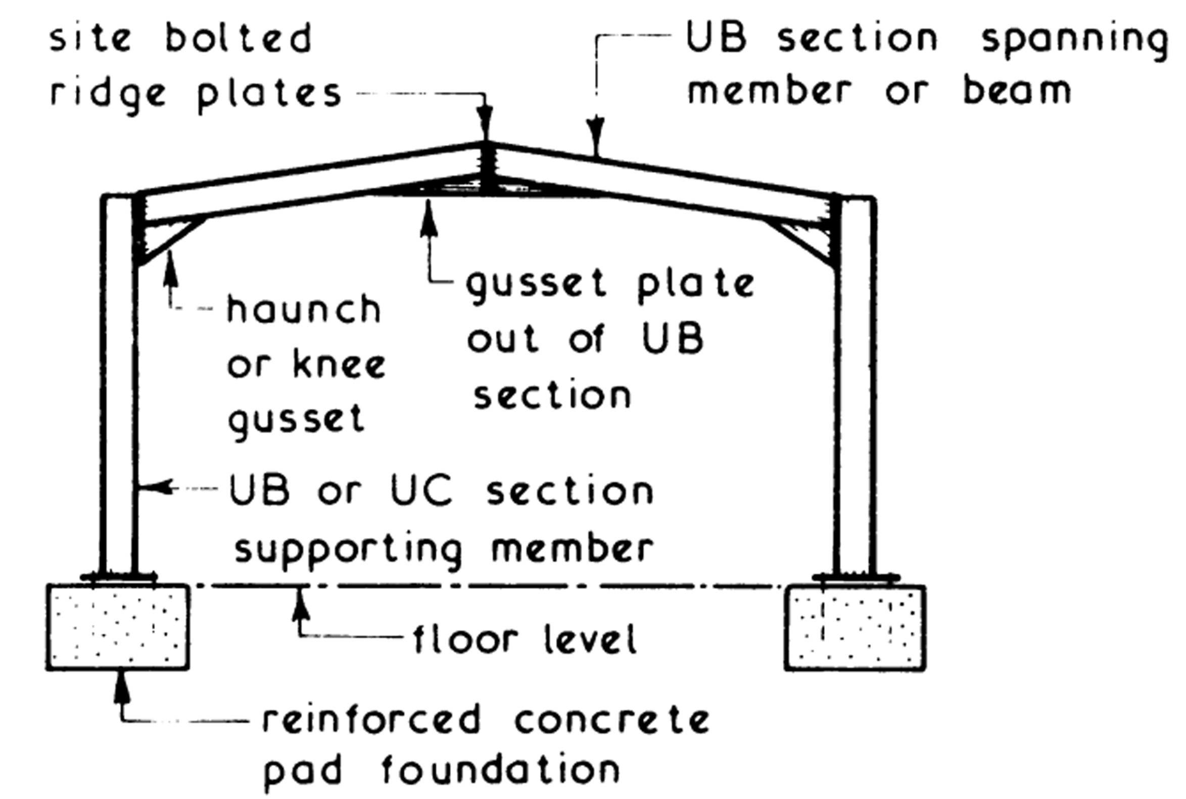
Typical Steel Portal Frame Details
Typical Single Span Portal Frame

Slide 35
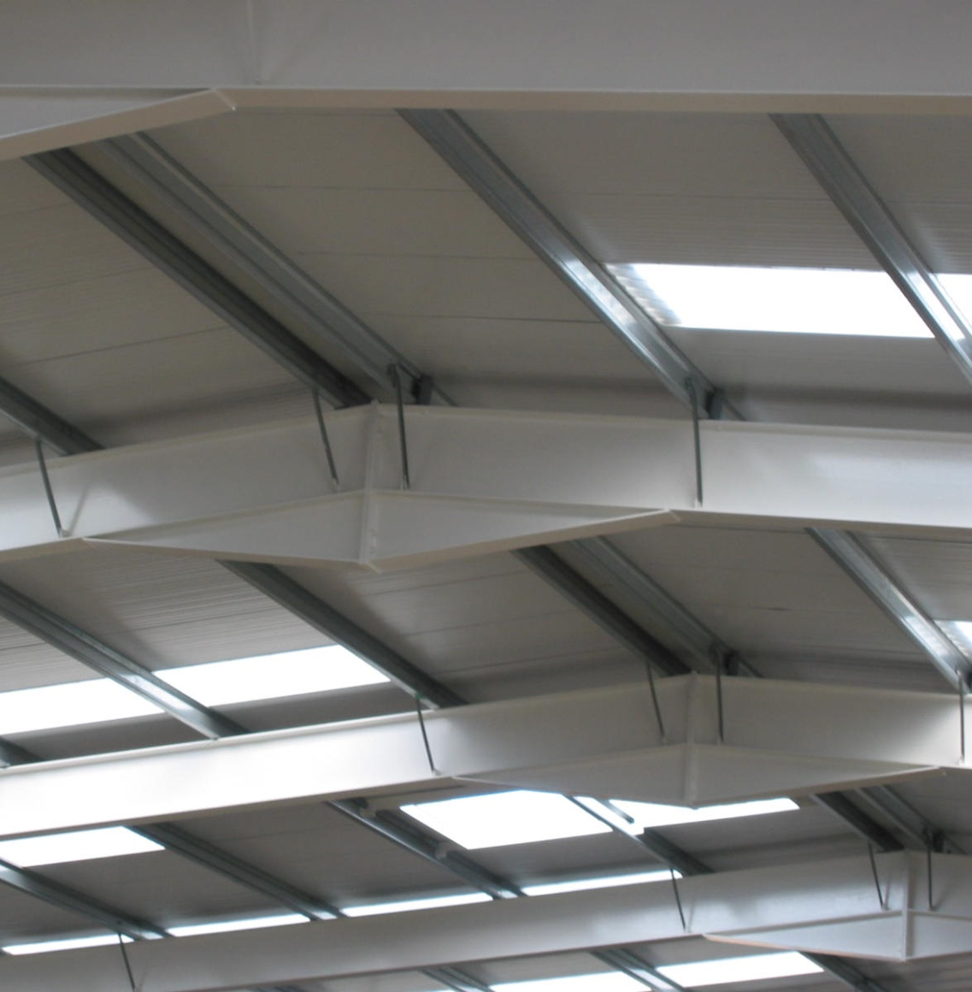
Typical Steel Portal Frame Details
Typical Single Span Portal Frame

Slide 36
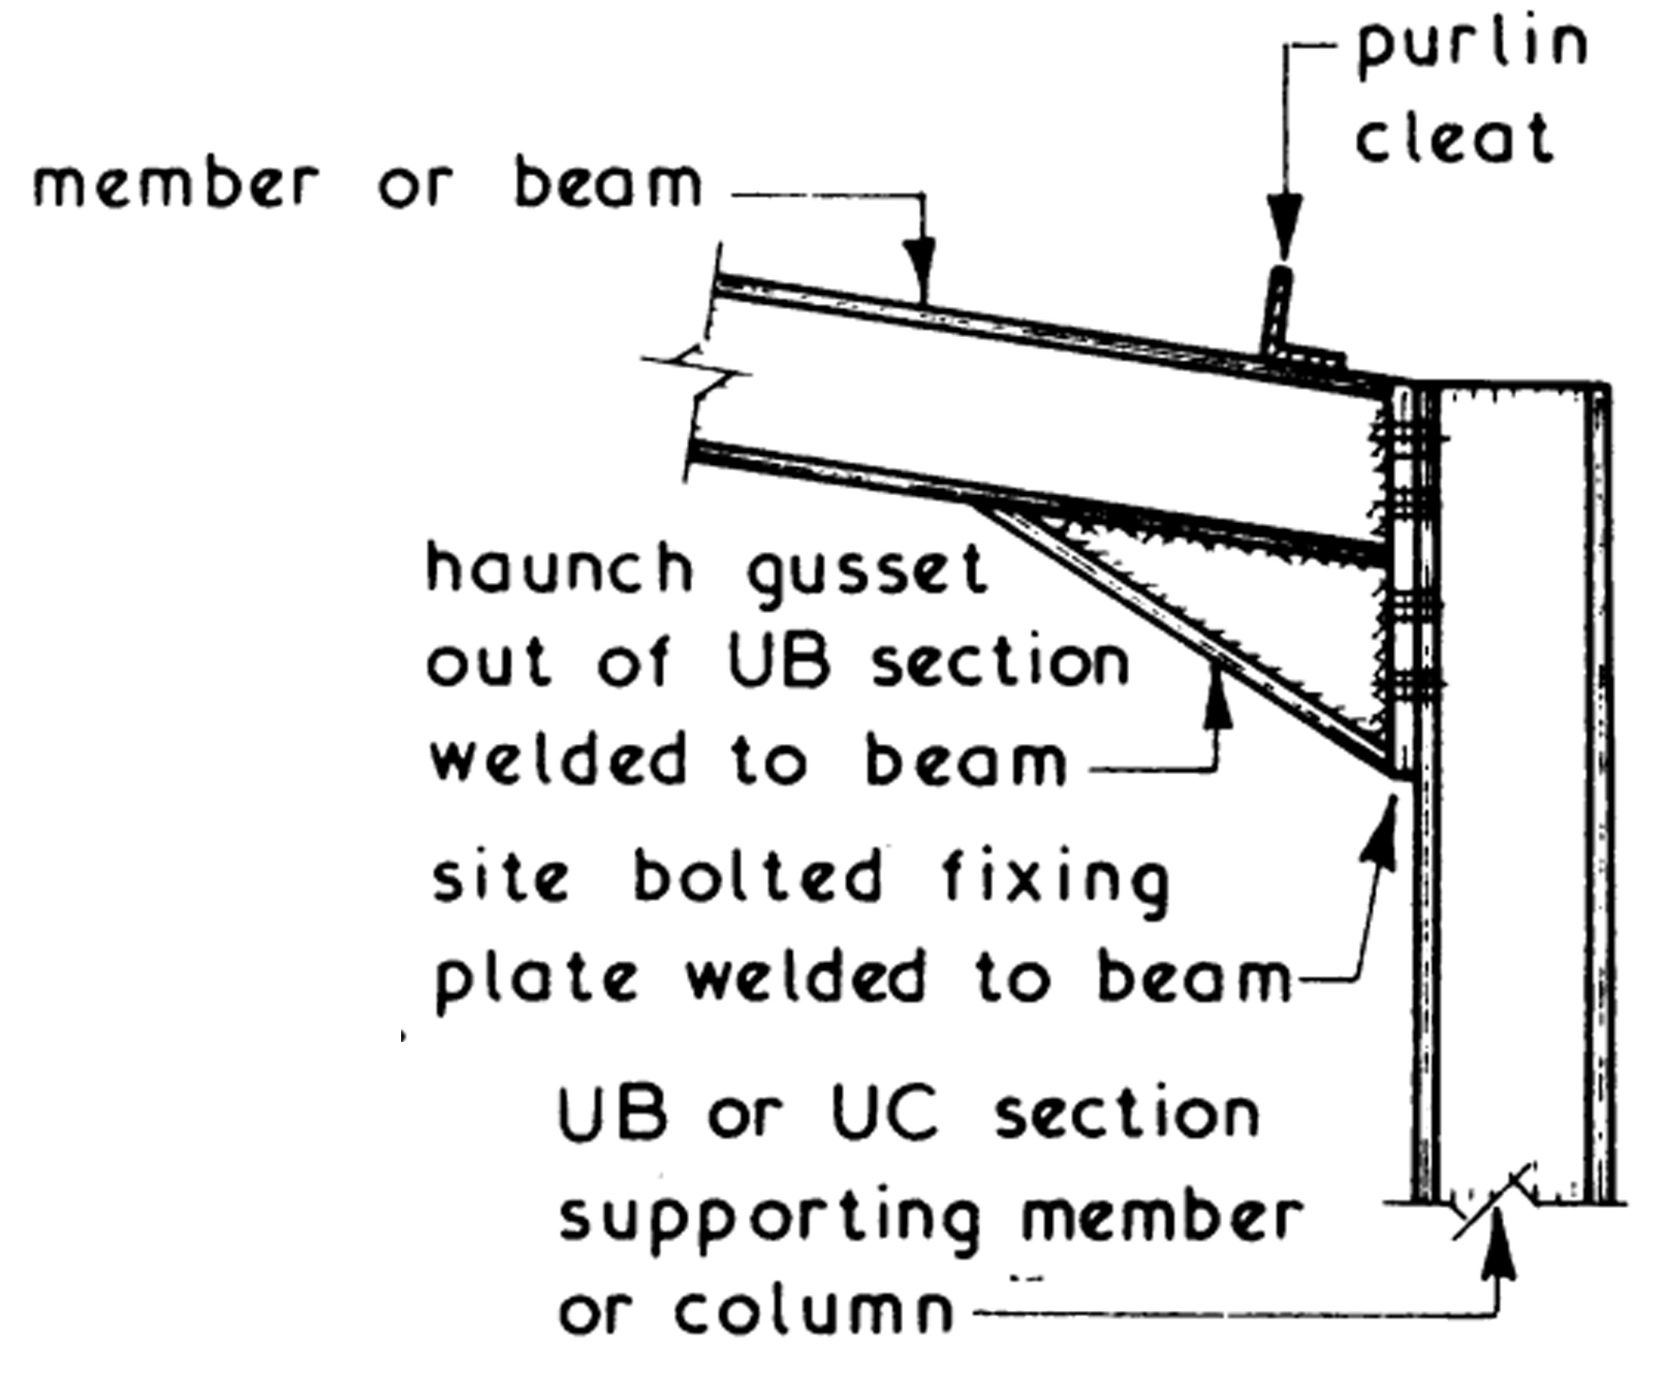
Typical Steel Portal Frame Details
Typical Beam to Column Joint

Slide 37
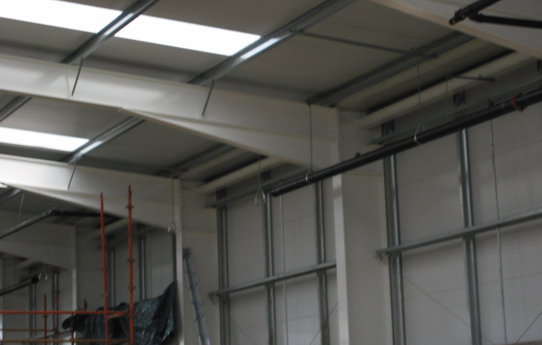
Typical Steel Portal Frame Details
Typical Beam to Column Joint

Slide 38
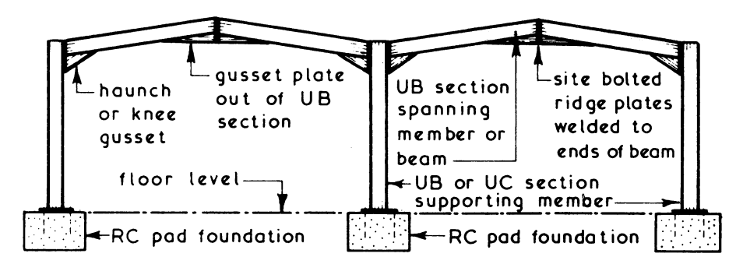
Typical Steel Portal Frame Details
Typical Multi-Span Portal Frame

Slide 39
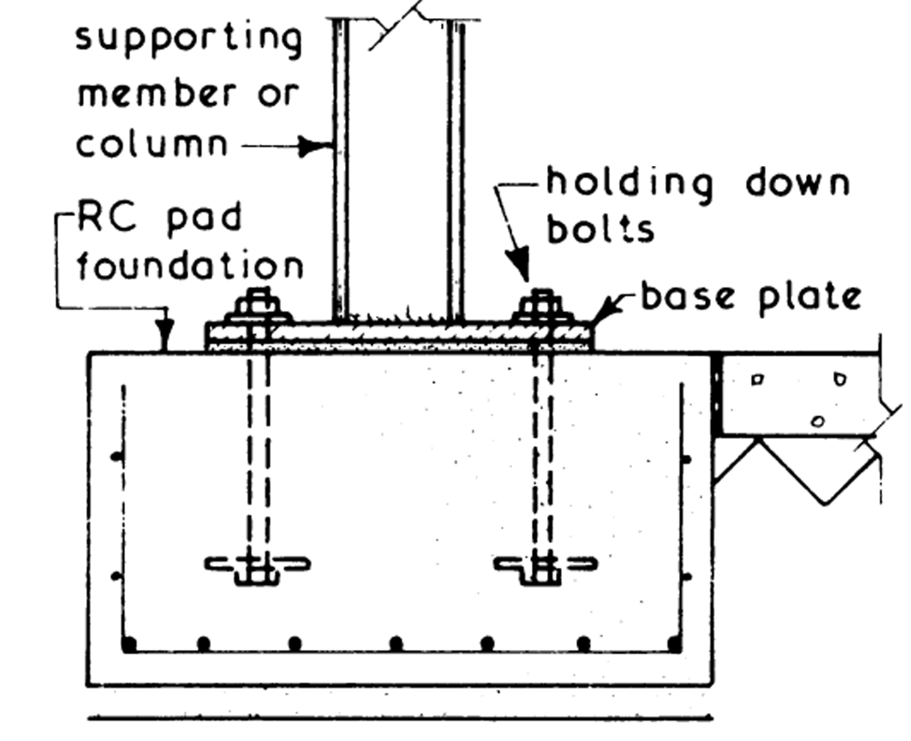
Typical Steel Portal Frame Details
Typical Foundation Details

Slide 40
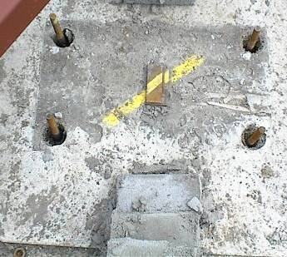
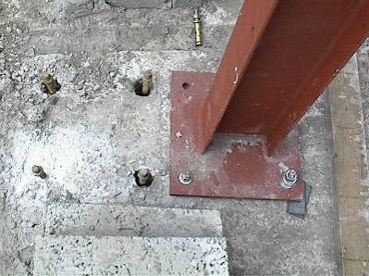
Typical Steel Portal Frame Details
Typical Foundation Details

Slide 41
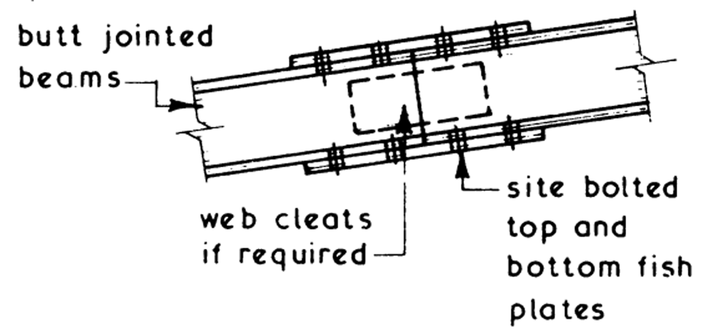
Typical Steel Portal Frame Details
Typical Splice Joint

Slide 42
Advantages and disadvantages of Steel Portal Frames
Advantages
Speed and ease of erection
Building can be quickly closed in and made water tight.
Framework prefabricated in a workshop and not affected by weather.
Site works such as drainage, roads etc can be carried out until framework is ready for erection.
No weather hold up during erecting the framework.
Connected together in factories by welding and site connections should be bolted.

Slide 43
Advantages and disadvantages of Steel Portal Frames
Disadvantages
Although steel is incombustible it has a poor resistance to fire as it bends easily when hot.
Subject to corrosion

Slide 44
TIMBER PORTAL FRAME

Slide 45
Timber Portal Frames
Combination of slender timber sections glued or/and nailed together
Usually fabricated in two sections for ease of transport and are bolted together at the ridge

Slide 46
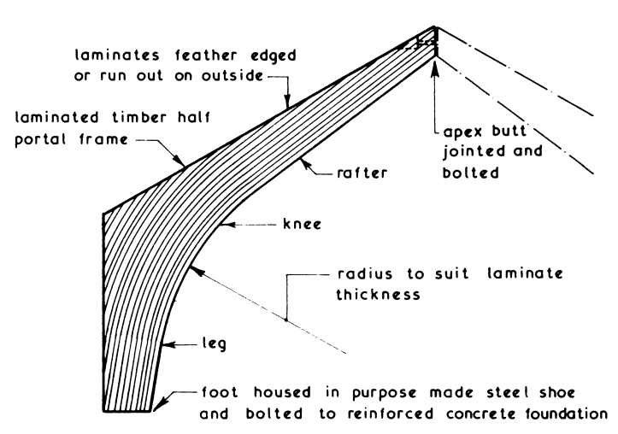
Timber Portal Frames
Typical laminated timber curved member

Slide 47
Timber Portal Frames
Advantages
Constructed from readily available material at economic cost
Light in weight
Easy to transport and erect
Can be trimmed and easily adjusted on site
Protection of fungi/termite attacked controlled by impregnation or surface treatment
Pleasing appearance with either natural timber or painted finish.

Slide 48
Thank you...

